Slide 1

WELCOME
Mst. Sharmin Akter
M.Sc- 2018
Roll No:14234759
Department Of Statistics,
University of Rajshahi.

Slide 2
Multiple Sequence Alignment
Topic Name

Slide 3
Outline
Multiple Sequence Alignment
Why we need MSA
Different methods of MSA
Pair-Wise Sequence Alignment
Dynamic programming approach
Iterative alignment
Muscle
Dialign
T-Coffee

Slide 4
Multiple Sequence Alignment
Multiple sequence alignment can be viewed as an extension of pair wise sequence alignment,
The complexity of the computation grows exponentially with the number of sequences being considered and their lengths.
Therefore, it is not feasible to search exhaustively for the optimal alignment even for a modest number of short sequences.

Slide 5
Example
For example, there are approximately 1038 possible alignments that can be produced from 10- nucleotide-long sequences
Possible Alignments
TCGGCTCGAC GAGCGTGAT- GGCGAGC--- CGTCGTAAC-
TCG-GC-TCGAC GAGCGT-GAT-- G-GCG-AG---C CG-TCGTA--AC
… 1038

Slide 6
Why we need MSA
Pair wise sequence alignment for more distantly related sequences is not reliable
It depends on gap penalties, scoring function and other details.
There may be many alignments with the same score – which is right?
Discovering conserved motifs in a protein family.

Slide 7
Different methods of MSA
Multiple Sequence Alignment (Alignment of > 2 Sequences)
Extending Dynamic Programming to more sequences
Progressive Alignment (Tree or Hierarchical Methods)
Iterative Techniques
(1) Stochastic Algorithms (SA, GA, HMM) (2) Non Stochastic Algorithms

Slide 8
Pair-Wise Sequence Alignment
Scoring Schemes or Weight Matrices
Identity Scoring
Genetic Code Scoring
Chemical Similarity Scoring
Observed Substitution or PAM Matrices
PEP91: An Update Dayhoff Matrix
BLOSUM(blocks substitution matrix): Matrix Derived from Ungapped Alignment
Matrices Derived from Structure

Slide 9
Pair-Wise Sequence Alignment
Techniques of Alignment
Simple Alignment, Alignment with Gaps
Application of DOTPLOT (Repeats, Inverse Repeats, Alignment)
Dynamic Programming (DP) for Global Alignment
Local Alignment (Smith-Waterman algorithm)

Slide 10
Pair-Wise Sequence Alignment
Important Terms
Gap Penalty (Opening, Extended)
Similarity/Dissimilarity Score
Significance Score (e.g. Z & E )

Slide 11
Dynamic programming approach
The basic idea of DPA is that, each sequence is split into two sub-sequences at location near the midpoint.
The splits partition the problem, into two sub-MSA problems with shorter sequences.
This process is repeated until the sequences become sufficiently short, i.e. shorter than a predefined threshold L.

Slide 12
Dynamic programming approach
These sub-multiple sequence alignments are then optimally aligned by dynamic programming method.
The alignments of these sub-problems are then concatenated yielding a multiple sequence alignment for the original sequence.
This algorithm is illustrated in Figure 1.

Slide 13
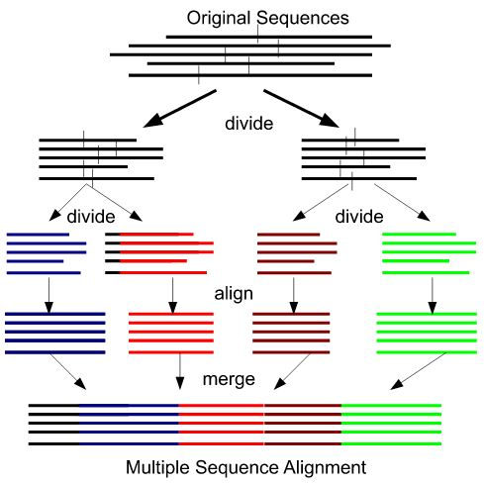
Dynamic programming approach
Figure 1: Illustration of the divide and conquer multiple sequence alignment (DPA).

Slide 14
Iterative alignment
Create a progressive alignment
After obtaining the alignment calculate a quality score(cost per click)
REPEAT THE FOLLOWING STEPS:
Redo the cluster tree
Realign the sequences using the new cluster tree
Calculate a quality score
Loop above can be stopped when a maximum number is reached or when quality score is not improved

Slide 15
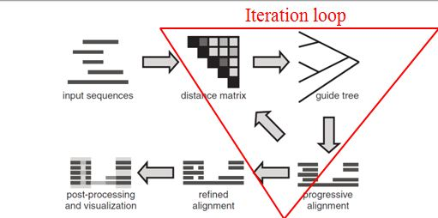
Iterative alignment
Allows correction of errors that was not possible in progressive alignment
Very popular among the MSA methods
Increases the running time of the method
Figure: Typical iterative MSA program workflow

Slide 16
Muscle
An iterative method that uses weighted log expectation profile scoring along with a slew of optimizations. MUSCLE uses two distance measures for a pair of sequences: a kmer distance (for an unaligned pair) and the Kimura distance (for an aligned pair)
It proceeds in three stages —
Draft progressive using kmer counting,
Improved progressive using a revised guide-tree from the previous iteration, and
Refinement by sequential deletion of each tree edge with subsequent profile re-alignment.

Slide 17
Muscle
Build quick approximate sequence similarity tree – without pair-wise alignment but compute distances by computing the number of short “hits” (short gapless matching) between any pair of sequences.
• Compute MSA using the tree. • Compute pair-wise distances from MSA and new tree • Re-compute MSA using new tree • Refine the alignment by iteratively partitioning the sequence into two groups and merging the aligning multiple alignment from the two groups

Slide 18
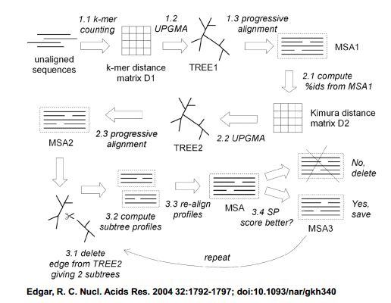
Muscle

Slide 19
DIALIGN
Pairs of sequences aligned to locate ungapped aligned regions.
Diagonals of various lengths identified.
Collection of weighted diagonals provide alignment.

Slide 20
T-Coffee
An MSA program
Uses principles similar to ClustalW
Combining sequence alignment method with structural alignment techniques
More accurate but longer running time
Limits to the number of sequences it can align (~100)

Slide 21
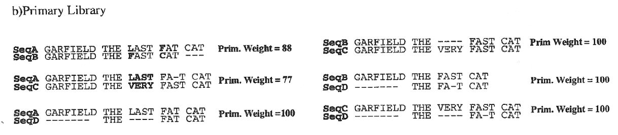
T-Coffee
Construct a library of pair-wise alignments
In library each alignment is represented as a list of pair wise residue matches (e.g. res.x sequence A is aligned with res. y of sequence B).
The weight of each alignment corresponds to percent identity (per aligned residue).

Slide 22
MSA: Problems
Sequences that are similar only in some smaller regions may be misaligned because MSA tries to find global, rather than local alignments.
Sequence that contains a large insertion compared to the rest may be misaligned because MSA tries to find global, rather than local alignments.

Slide 23
MSA: Problems
Sequence that contains a repetitive element (such as a domain), while another sequence only contains one copy.
VS

Slide 24
MSA: Problems
Pairwise alignment is an optimal algorithm.
Multiple alignment is not an optimal algorithm. Better alignments might exist.
The algorithm yields a possible alignment, but not necessarily the best one.
Because of the progressive methodology, errors at the beginning of the alignment are more important than errors at the end of the alignment.

Slide 25
Conculation
MSA is relevant for many analysis tasks
Improved signal from the alignment
Solving MSA requires heuristics
Selection of MSA methods depends on the application
Results should be evaluated by eye
and the errors should be corrected with MSA editors

Slide 26
Any Question?

Slide 27
Thank You

